Slide 1

kuala lumpur
Jupyter Notebook Super Basic Instruction

Slide 2
Step 0 - go to the link below and download Anaconda (python 3+)
http://www.anaconda.com/download
After you have installed Anaconda, follow the steps in the next slides

Slide 3
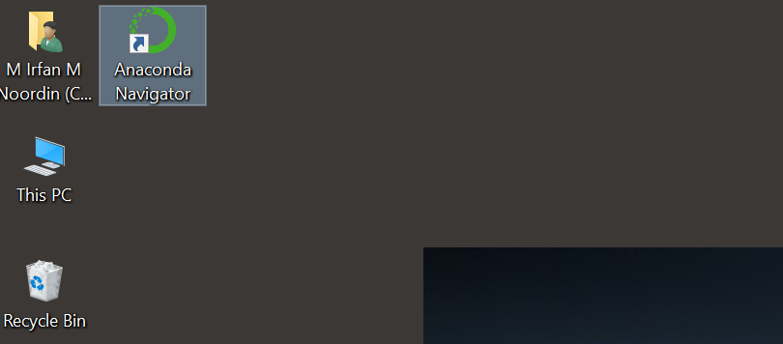
Step 1 - Click on the Anaconda navigator Icon on your desktop

Slide 4
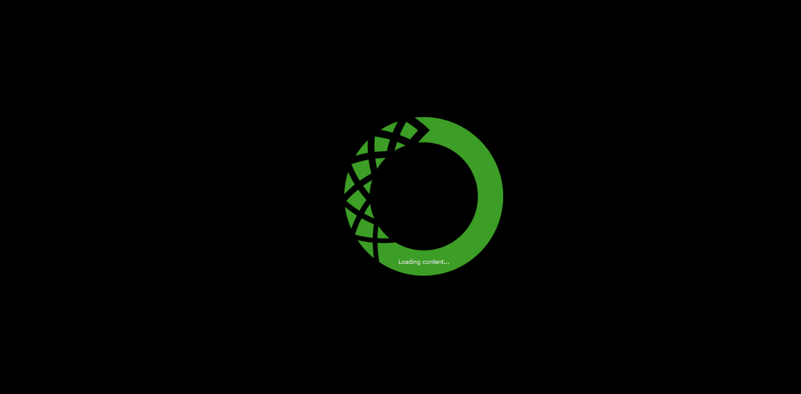
Step 2 - You will see the Anaconda loading icon
Have patience young padawan ( it may take a while)

Slide 5
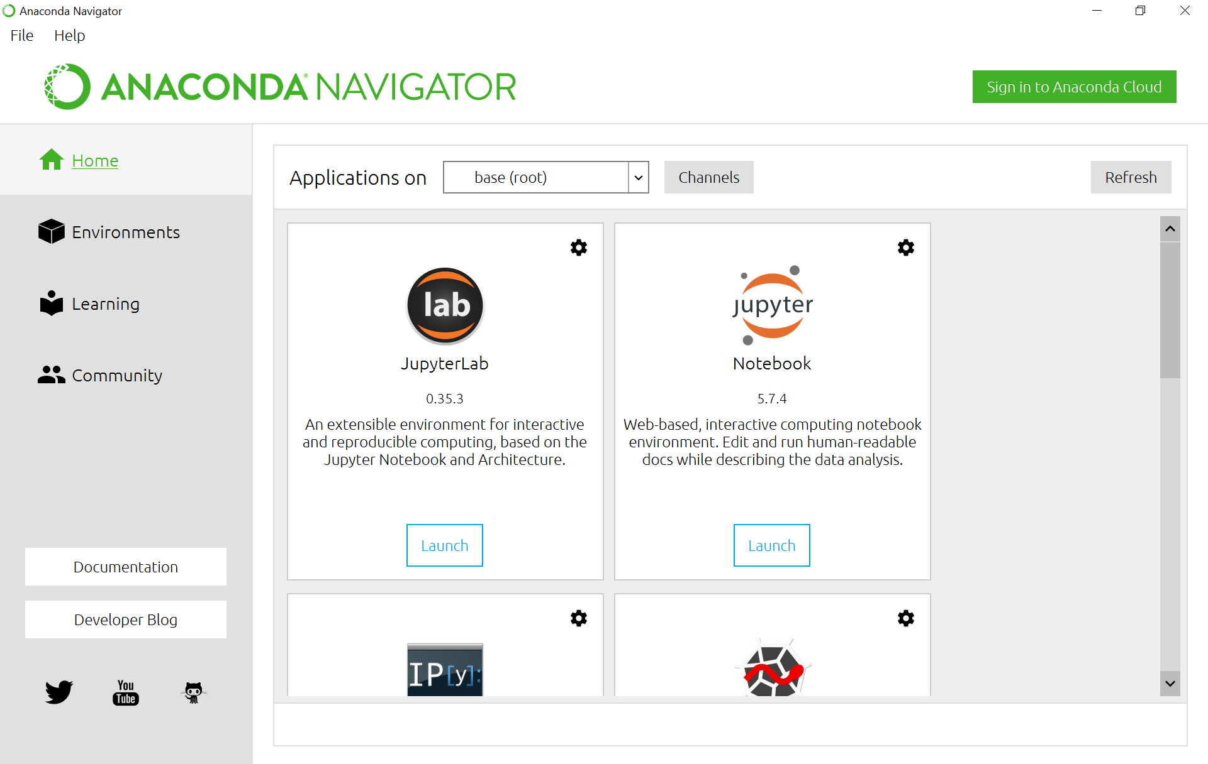
Step 3 - Open Jupyter Notebook

Slide 6
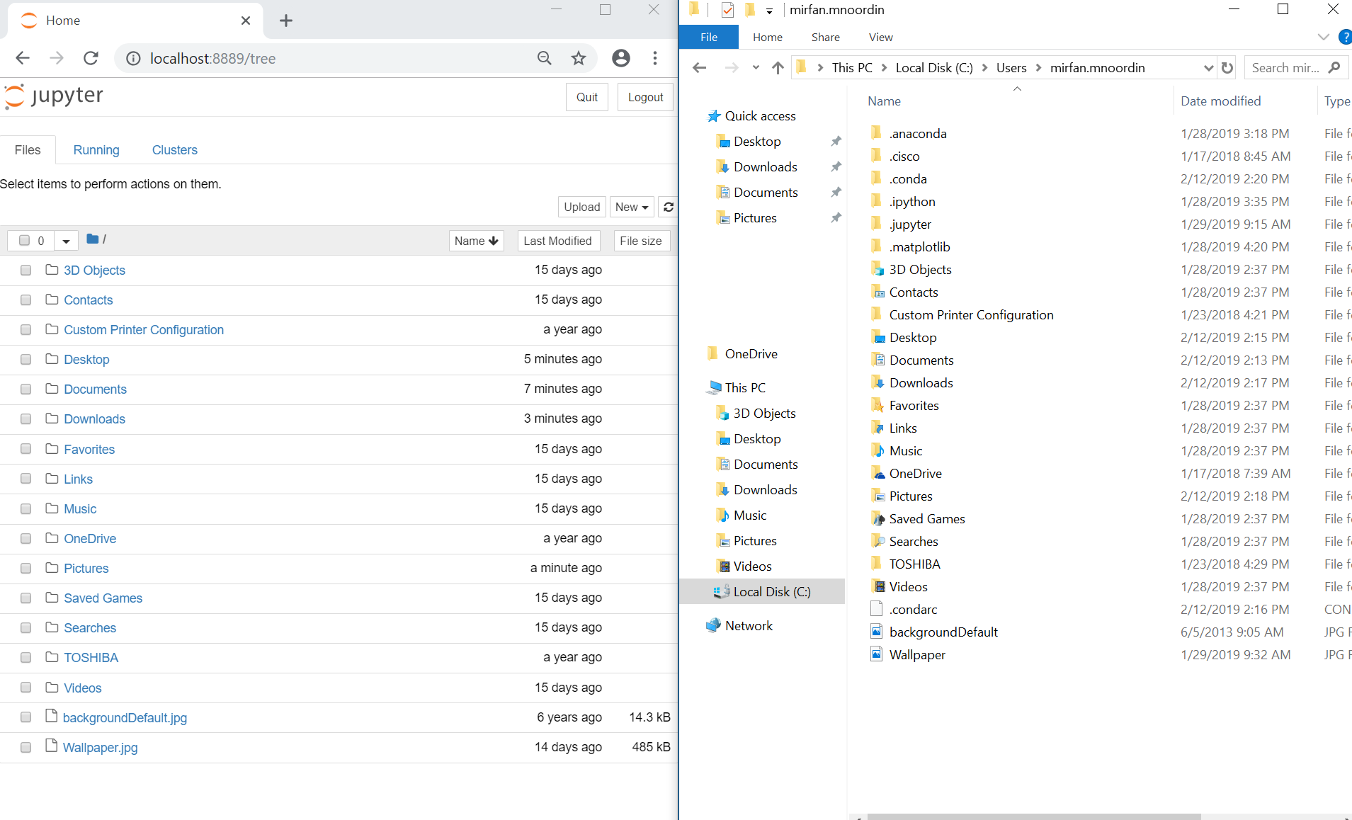
Step 4 - Jupyter will show a directory which will be the same as your user’s directory

Slide 7
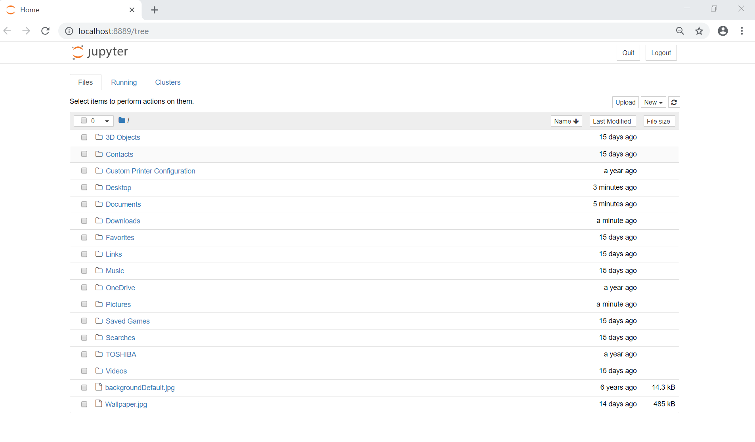
Step 5 - Choose a folder to save your file in. I will choose Desktop

Slide 8
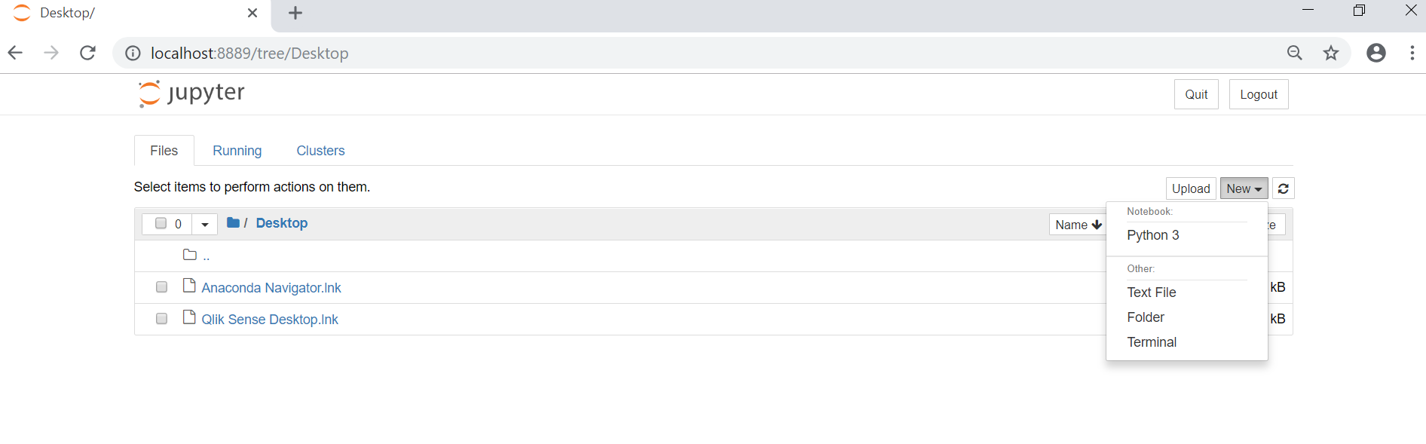
Step 6 - Create new file , choose python3

Slide 9
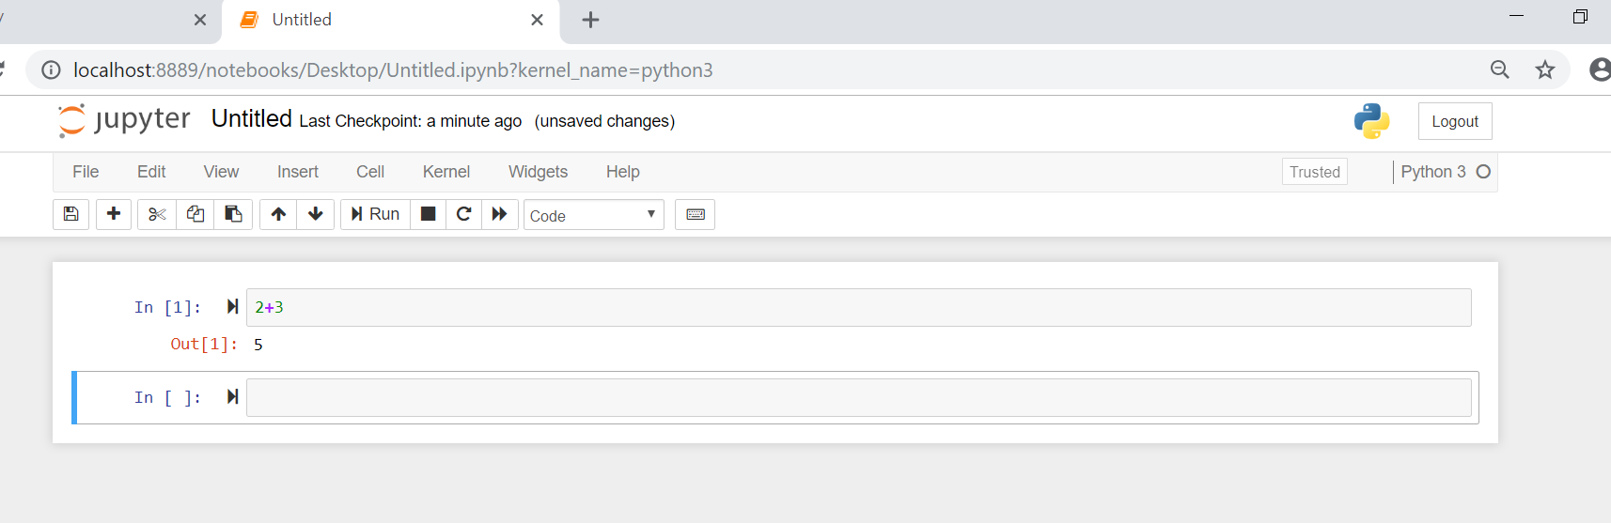
Step 7 - Test code
shift + enter will execute the code in the cell and create a new cell at the bottom

Slide 10
Step 8 - Rename Jupyter Notebook

Slide 11
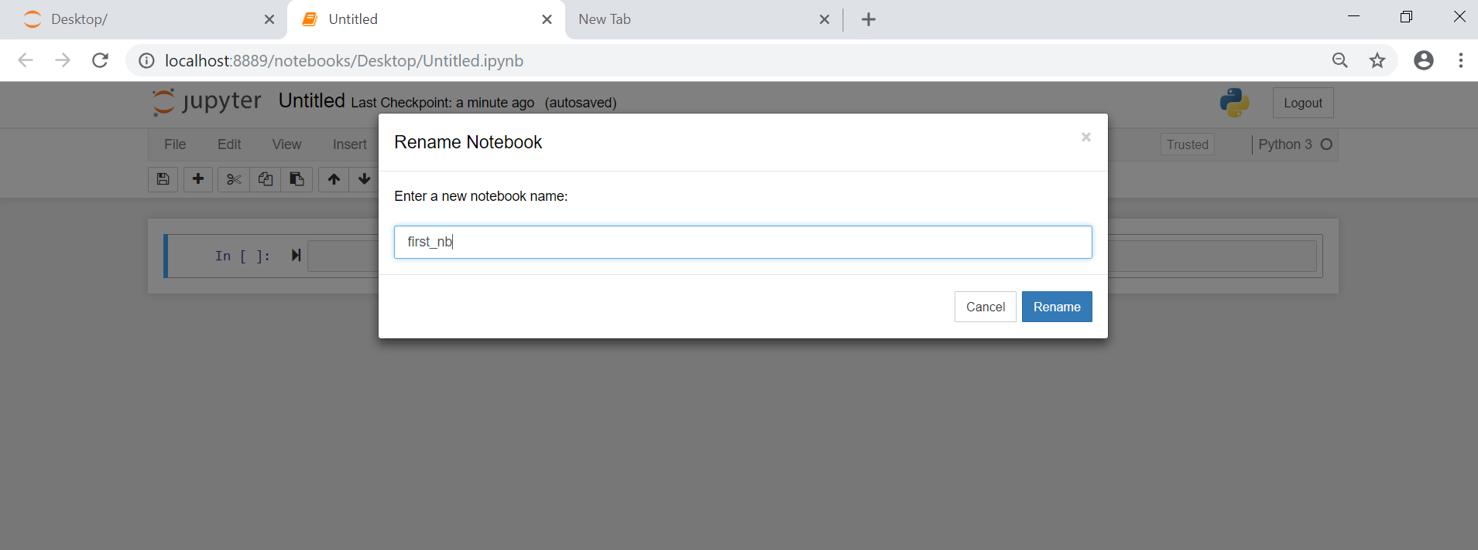
Step 8 - Rename and Save Jupyter Notebook

Slide 12
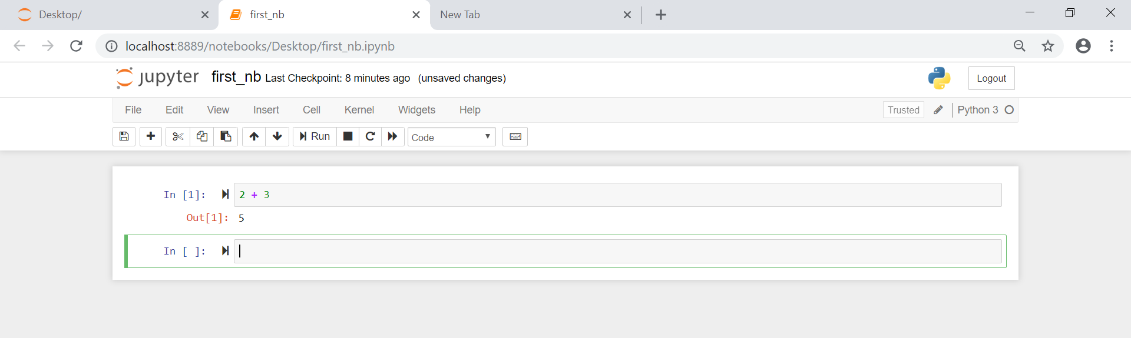
Step 9 - Save Jupyter Notebook

Slide 13
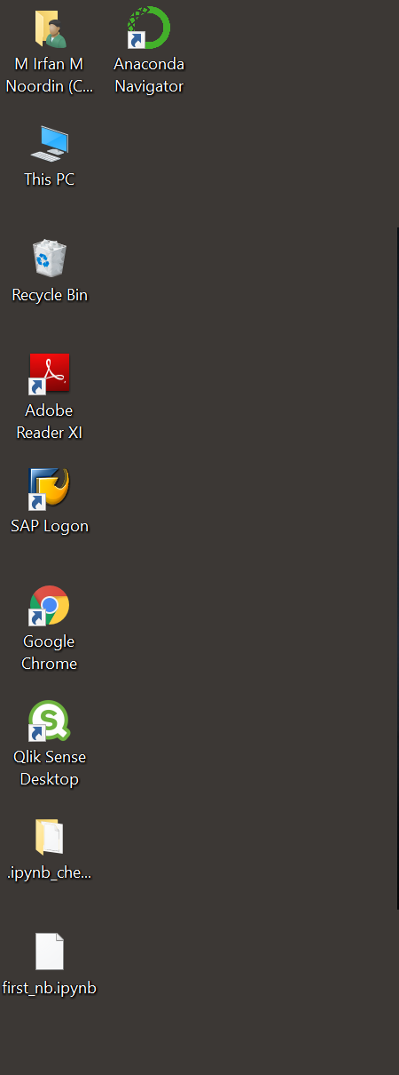
You can view the first_nb.ipynb file at your desktop now

Slide 14
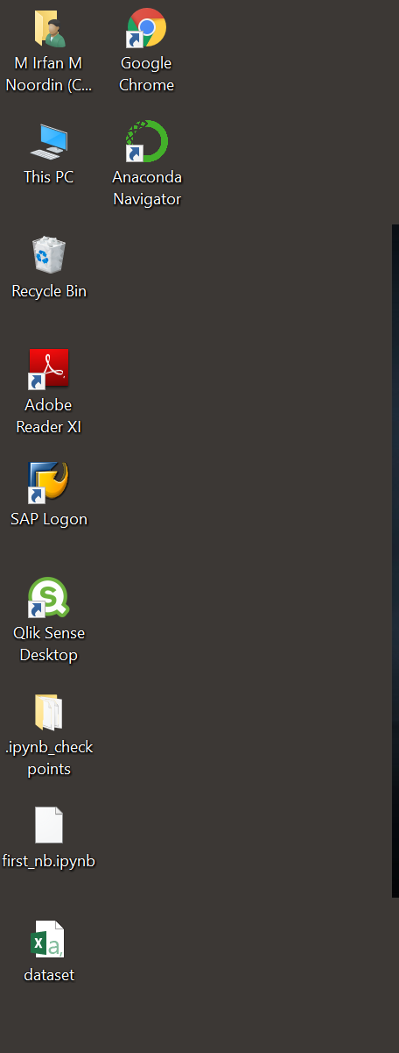
Step 10 - Load dataset
First save the dataset in the same folder as your jupyter notebook file I will save it on Desktop

Slide 15
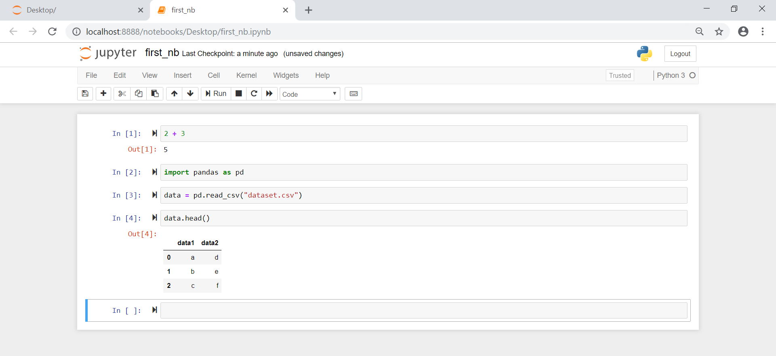
Step 11 - Write code in jupyter to load dataset

Slide 16
Congrats !!! You made your first Jupyter Notebook !

